Slide 1

MSIS LAB
Introduction To
MSIS Lab Research (V2X for Self Driving)
2018. 05
Prof. HyungWon Kim
MSIS LAB
Department of Electronics Engineering
Chungbuk National University

Slide 2
MSIS Lab’s Research (Wireless & Deep Learning)
Deep Learning AI & Image Recognition
◇ Object and Environment Recognition for Smart Car (Autonomous Vehicle)
◇ Multi-Sensor Fusion Algorithm for Vehicle Tracking Enhancement
◇ Multi-Vehicle Senor Fusion Using V2X (Vehicle-to-Anything) Communication
◇ Moving Object Detection, Classification, Identification, Tracking with Fast CNN (Convolutional Neural Network)
◇ Low Power & Compact Neural Network Algorithm for IoT (Internet of Things)
◇ Image Recognition for IoT Sensors (Wireless Metering, Environment monitor)
◇ Embeded Programming on ARM Cortex M4, Cortex A9, with RTOS, Linux
Smart Car V2X Network & Wireless Sensor Network
◇ Enhanced V2X Network for transmitting Sensor data & Safety Decision
Inforamtion between Smart Cars (Autonomous Vehicles)
◇ Multi-Hop Reliable Broadcast with TDM Scheduling for High speed, low latency, guaranteed delivery of congested V2X networks
◇ Wide-Range LDM (Local Dynamic Map) Generation and transmission method
◇ Automonous driving safety decision algorithms using Wide-Range LDM:
FCW (Forward collision warning), LCW (Lane change warning), EEBL (Electronic
Emergency Brake), IMA (Intersection Movement Assist), LTA (Left Turn Assist)

Slide 3
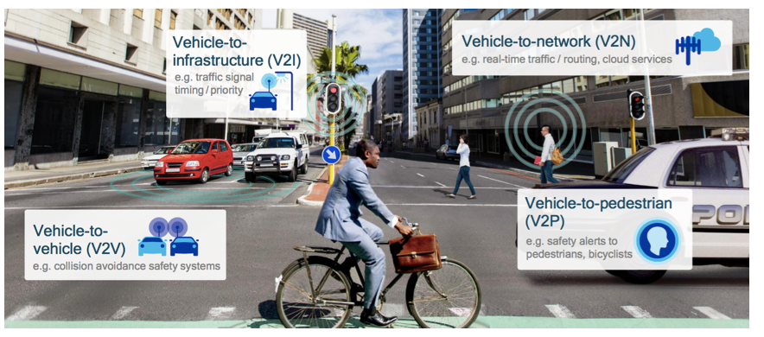
V2X: Applications for Connected Car
Collision avoidance: V2I & V2V (V2X)
Cloud service: V2N
Pedestrian safety: V2P

Slide 4
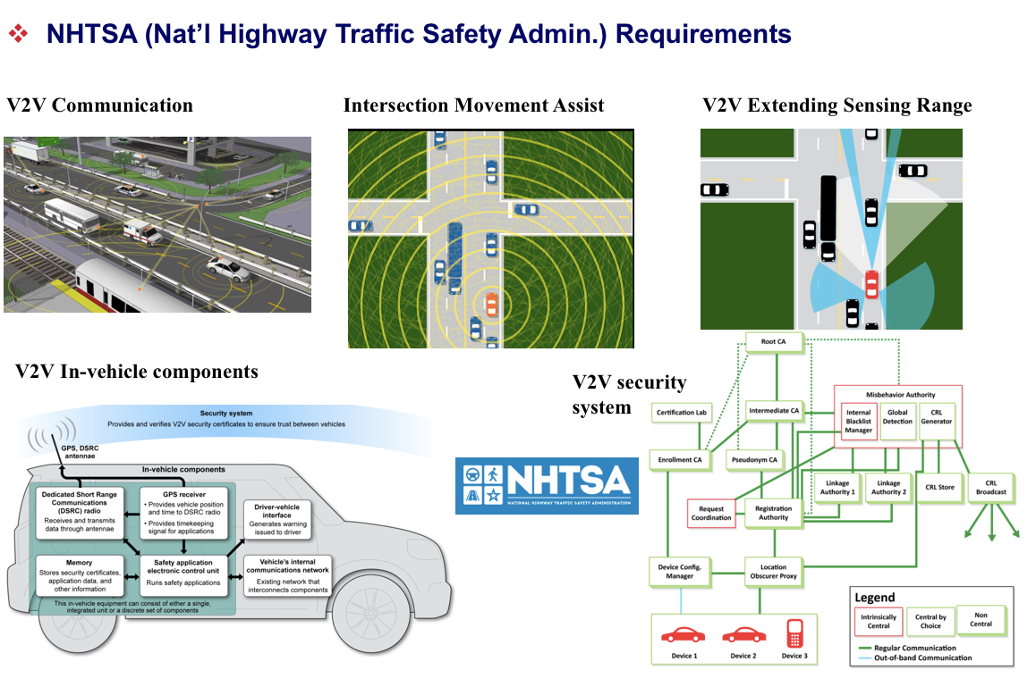
V2X Standard in US: Planned Mandates

Slide 5
V2X Standards Trend & Projection
2002
2012
2016
2019
2023
IEEE
802.11p
Released
IEEE 1609
V2X Law
Enforced
V2X
Equipped
Cars
5.9GHz
Allocation
WAVE
+
C-ITS
Consolidation
US: WAVE/DSRC
WAVE+
C-ITS
+
C-V2X
Consolidation
Release1
Release2
EU: ETSI/C-ITS (G5)
Celluar-V2X
Standard
Group (R12)
Release
R14
Release
R17
Deployed
Cellular: 3GPP/C-V2X (LTE/5G /w D2D)

Slide 6
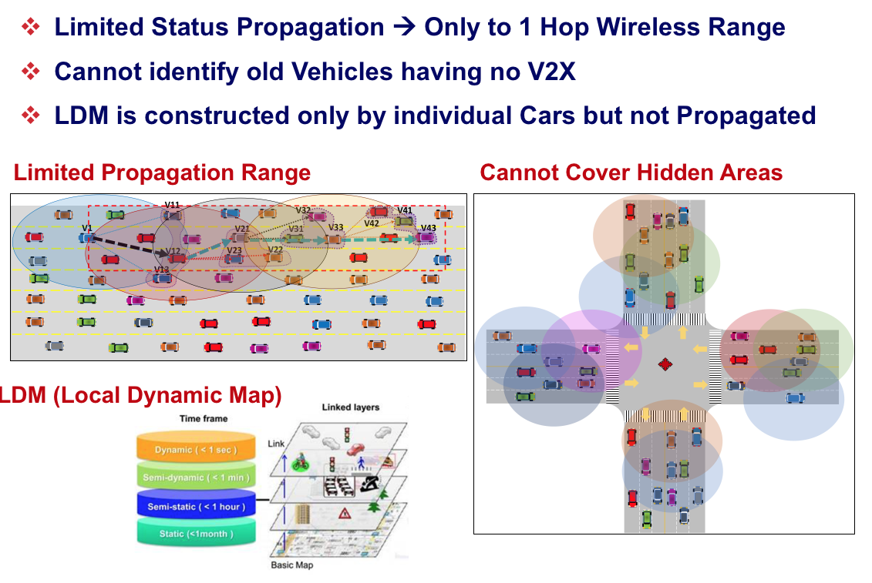
Limitation of Current V2X

Slide 7
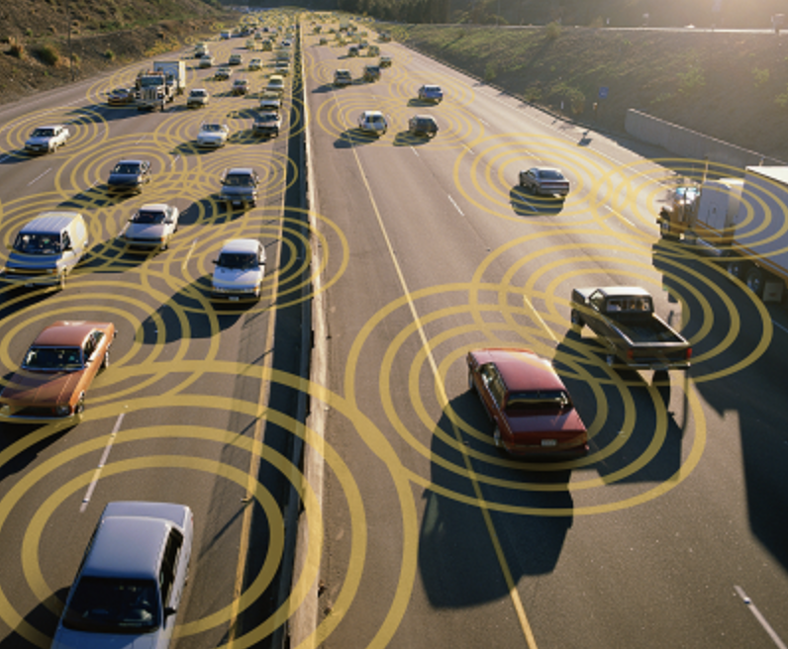
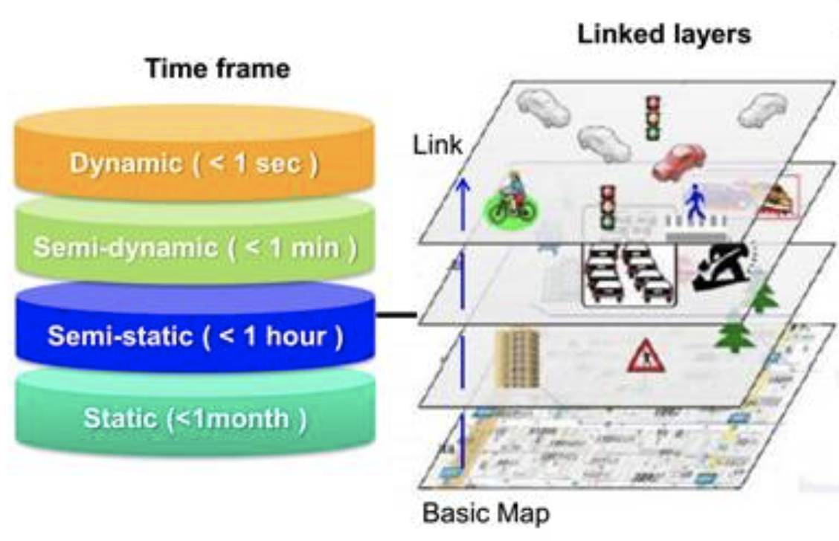
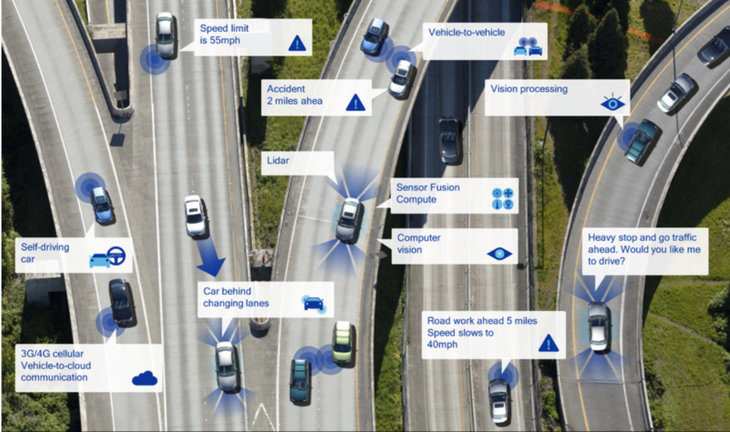
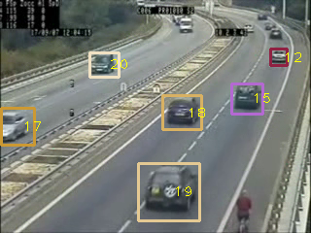
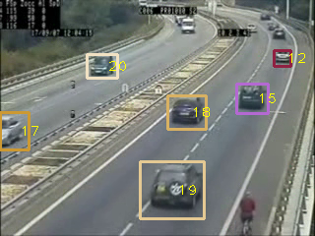
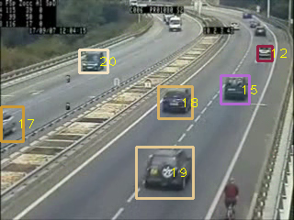
Enhancing V2X: Multi-hop & Sensing Fusion
Smart V2X Network for Wider Coverage
Problem: Single Car Sensing ADAS ➔ Limits Autonomous Vehicles only to low speed
Problem: Using current V2X Standard ➔ Slow down the adoption of V2X and autonomous cars
Solution: Adaptive Multi-Hop LDM Propagation ➔ Guarantee large scale V2X coverage Multi-Car Sensing Data Fusion ➔ Accurate LDM for Wider Coverage
Problem: Short Range Coverage of only Positions
Enhancement:
Multi-Hop LDM+ Sensing Fusion
Goal: Intelligent Wide Range Mobility Map

Slide 8
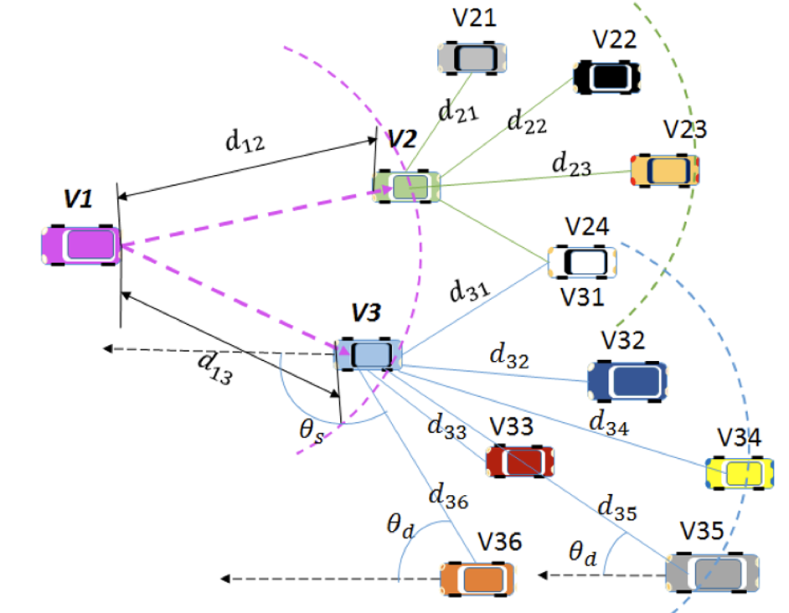
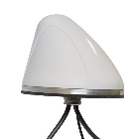
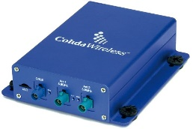
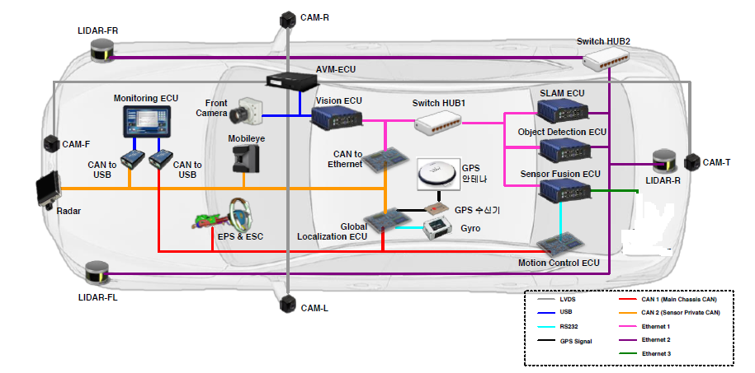
Development Platform for Enhanced V2X with Sensing Fusion
V2X H/W & S/W Architecture
Multi-Hop
V2X Protocol
V2X/GPS Antenna
V2X OBU Module
(Cohda MK5 V2X)
LDM Generation
Veh. Path Prediction
Target Platform: In-Vehicle Sensors: Cameras, Lidar, Radar, IMU sensors
TX/RX BSM
packets
V2X Safety App S/W
IEEE1609/802.11p Protocol
TCP/IP
To ECUs
Linux OS
V2X Software Architecture

Slide 9
Target V2X Software Structure
Enhanced V2X Safety Applications Mandated by US NHTSA
Emergency Electronic Braking Lights(EEBL)
Do Not Pass Warning(DNPW)
Reduced Speed Zone Warning(RSZW)
Blind Spot / Lane Change Warning (BSW/LCW)
Intersection Movement Assistant(IMA)
Curve Speed Warning(CSW)
Develop:
V2X Safety
Application
Layer
Forward Collision Warning(FCW)
Left Turn Assist(LTA)
Red Light Violation Warning(RLVW)
IEEE 1609.2
Security Service
Enhanced priority scheme to expedite safety application processing
Adaptive non-linear random DCF back-off mechanism
Multi-Hop Broadcaster Selection (Collision Reduction)
Develop:
WAVE
Enhancement
Protocol
Dynamic TDMA based Collision avoidance
Adaptive cross layered control mechanism to fit in WAVE and C-ITS
Adaptive TDM Code Allocation (Collision-Free)
IEEE 802.2 LLC Sublayer
IEEE 1609.4 MAC Sublayer Extension
IEEE 802.11p MAC Sublayer
IEEE 802.11p PHY Sublayer

Slide 10
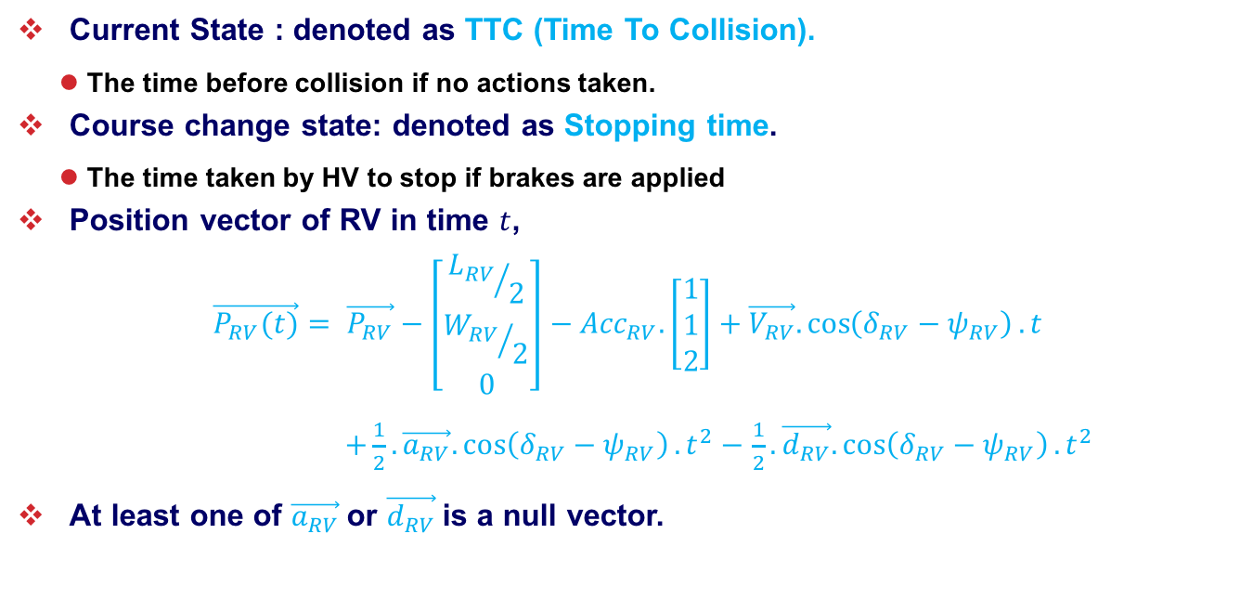
V2X Safety Application 1: FCW (Forward Collision Warning) Prediction
Current State : denoted as TTC (Time To Collision).
The time before collision if no actions taken.
Course change state: denoted as Stopping time.
The time taken by HV to stop if brakes are applied
Position vector of RV in time $t$,
$$\vec{P_{RV}(t)}= \vec{P_{RV}}−\left[\begin{aligned}{L_{RV}}/2 \\ {W_{RV}}/2 \\ 0\end{aligned}\right]−{Acc}_{RV}.\left[\begin{aligned}1 \\ 1 \\ 2\end{aligned}\right]+\vec{V_{RV}}.\cos\left(δ_{RV}−ψ_{RV}\right).t$$
$+\frac{1}{2}. \vec{a_{RV}}.\cos\left(δ_{RV}−ψ_{RV}\right).t^{2}−$ $\frac{1}{2}.\vec{d_{RV}}.\cos\left(δ_{RV}−ψ_{RV}\right).t^{2}$
At least one of $\vec{a_{RV}}$or $\vec{d_{RV}}$is a null vector.

Slide 11
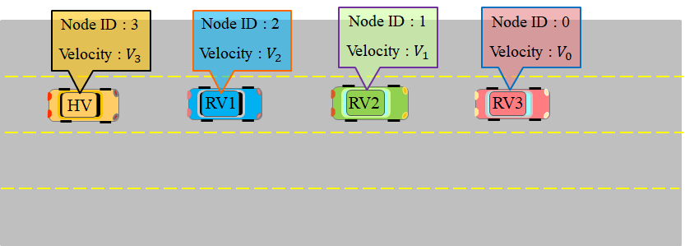
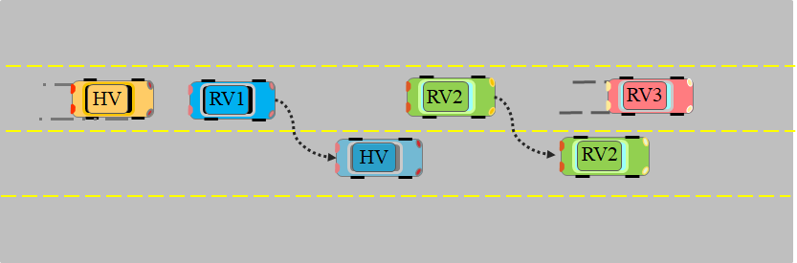
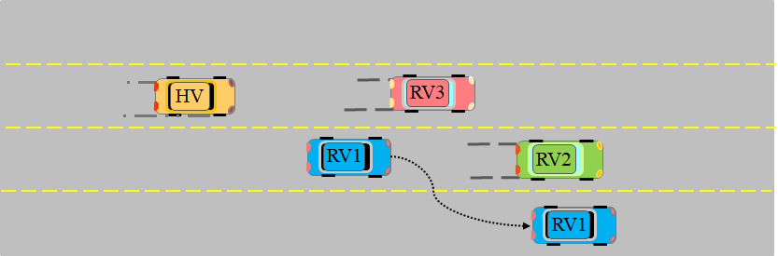
V2X Safety Application 2: EEBL (Electronic Emergency Brake Light) Warning
Four vehicles are moving to righthand direction with different speed.
Each vehicle is equipped with collision warning system.
RV3 uses EEBL to avoid the collision
Once RV2, RV1 and HV receive EEBL message, they will take proper action to avoid the collision.
Since RV1 and RV2 has shorter distances to RV3, they change the lane.
HV spots after having enough space.
Then RV2 detects the object on his lane, it uses EEBL to avoid the crash.
RV1 has high speed and short space to stop and it changes its lane to avoid the collision.

Slide 12
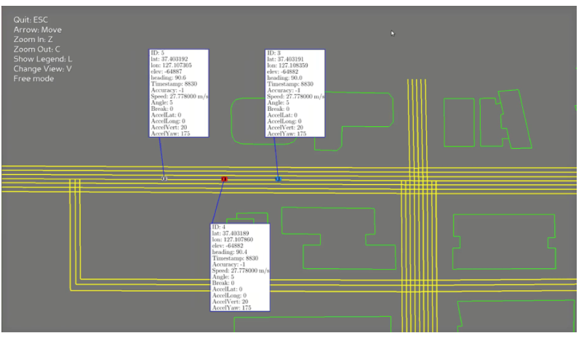
V2X Safety Application 2: Test Result EEBL (Electronic Emergency Brake Light) Warning
EEBL Ported on to V2X Hardware
Emulation Demo with VSIM and 3 V2X modules

Slide 13
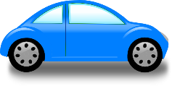
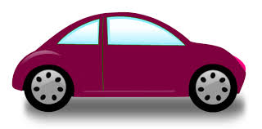
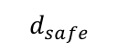
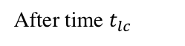
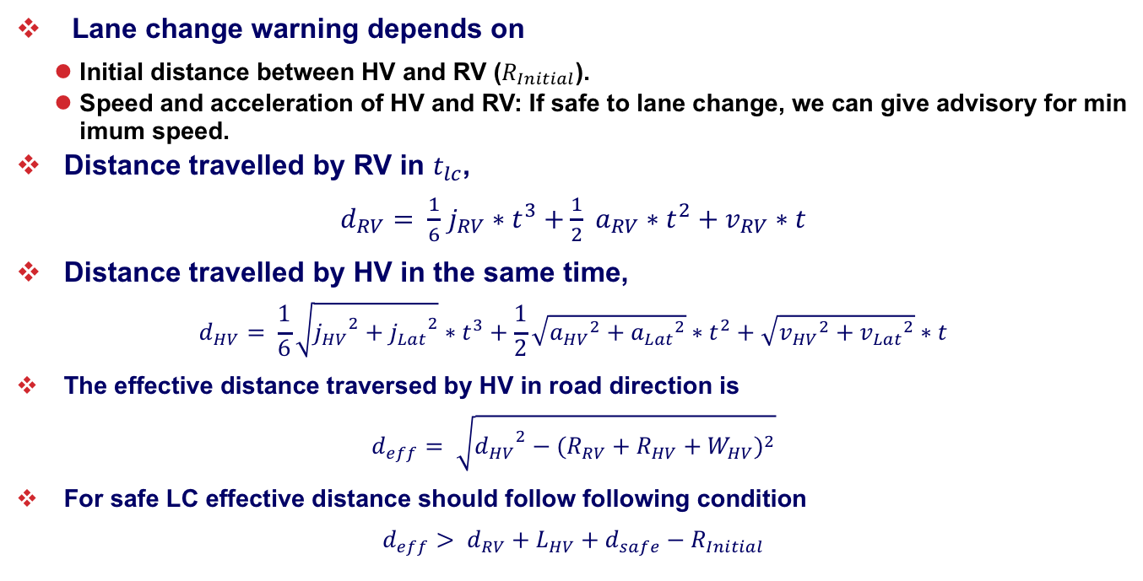
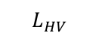
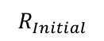
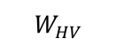
V2X Safety Application 2: Lane Change Warning (LCW)
Lane change warning depends on
Initial distance between HV and RV ($R_{Initial}$).
Speed and acceleration of HV and RV: If safe to lane change, we can give advisory for minimum speed.
Distance travelled by RV in $t_{lc}$,
$d_{RV}= \frac{1}{6}$ $j_{RV}∗t^{3}+\frac{1}{2} a_{RV}∗t^{2}+v_{RV}∗t$
Distance travelled by HV in the same time,
$$d_{HV}= \frac{1}{6}\sqrt{{j_{HV}}^{2}+{j_{Lat}}^{2}}∗t^{3}+\frac{1}{2}\sqrt{{a_{HV}}^{2}+{a_{Lat}}^{2}}∗t^{2}+\sqrt{{v_{HV}}^{2}+{v_{Lat}}^{2}}∗t$$
The effective distance traversed by HV in road direction is
$$d_{eff}= \sqrt{{d_{HV}}^{2}−{(R_{RV}+R_{HV}+W_{HV})}^{2}}$$
For safe LC effective distance should follow following condition
$$d_{eff}> d_{RV}+L_{HV}+d_{safe}−R_{Initial}$$
$$R_{Initial}$$
After time $t_{lc}$
$$W_{HV}$$
$$d_{safe}$$
$$L_{HV}$$

Slide 14
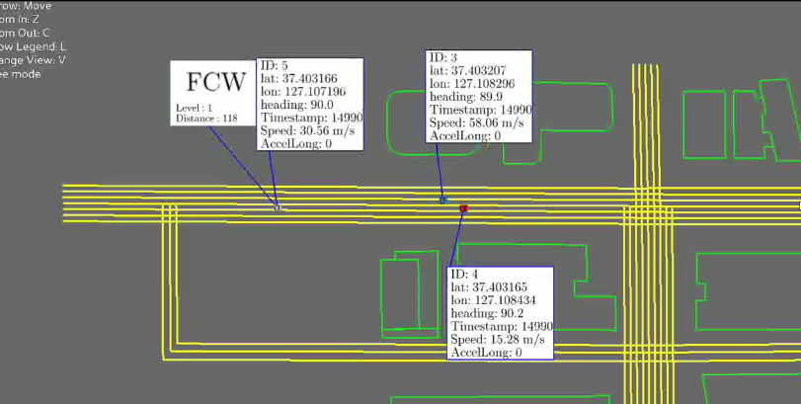
LCW Test Result: When the Next Lane is Available

Slide 15
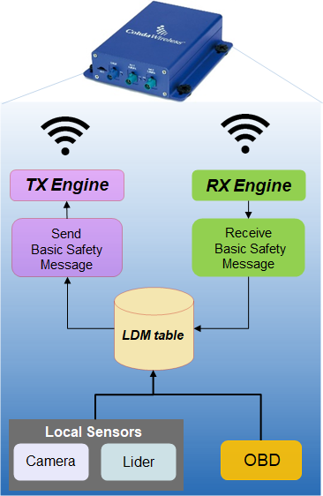
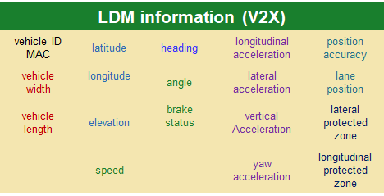
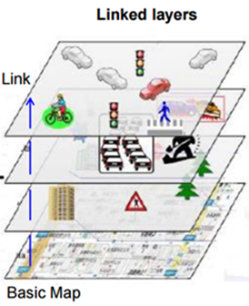
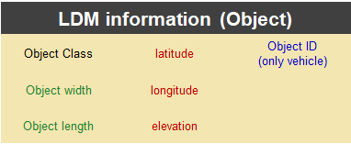
Generate LDM (Local Dynamic Map)
LDM:
Updates vehicle status upon received BSM
Provides up-to-date information to BSM generation function.
Executes self-estimation to purge aged information

Slide 16
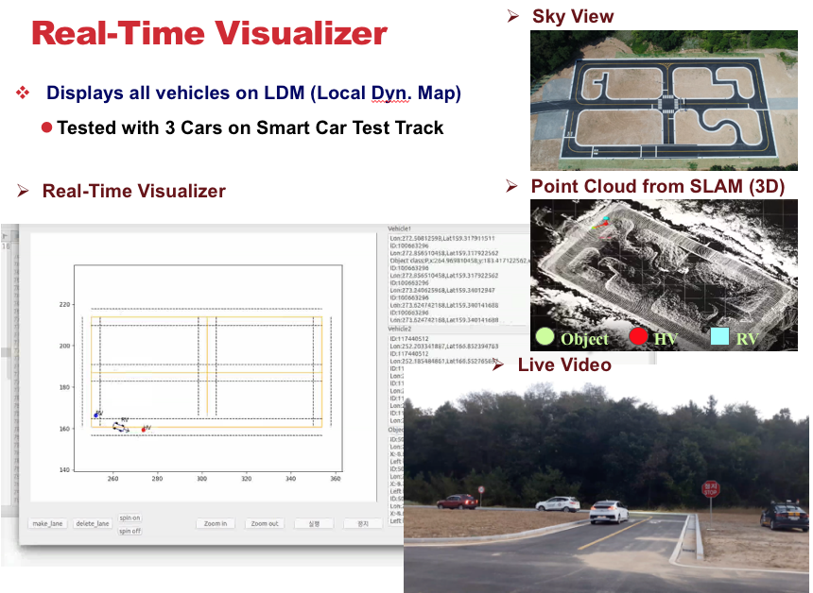

Slide 17
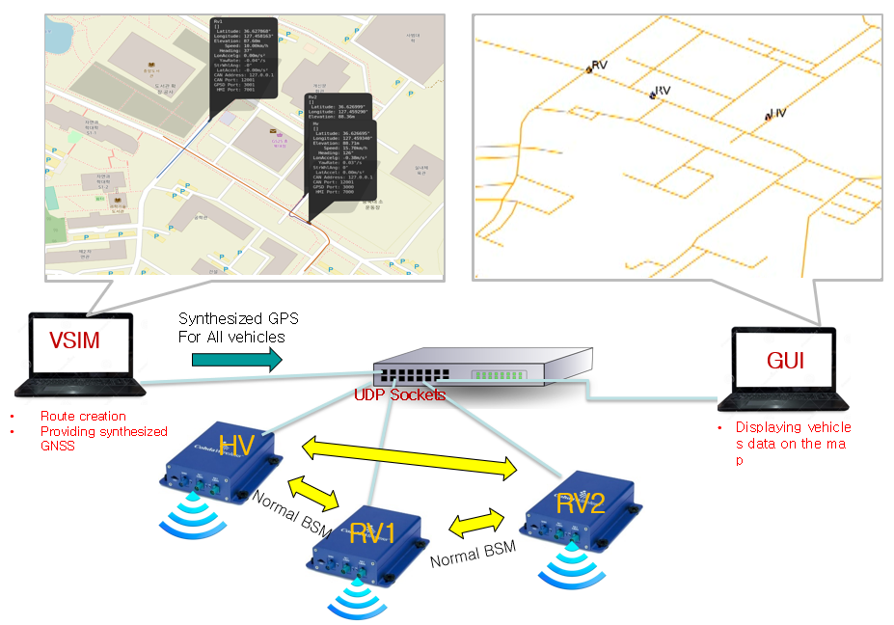
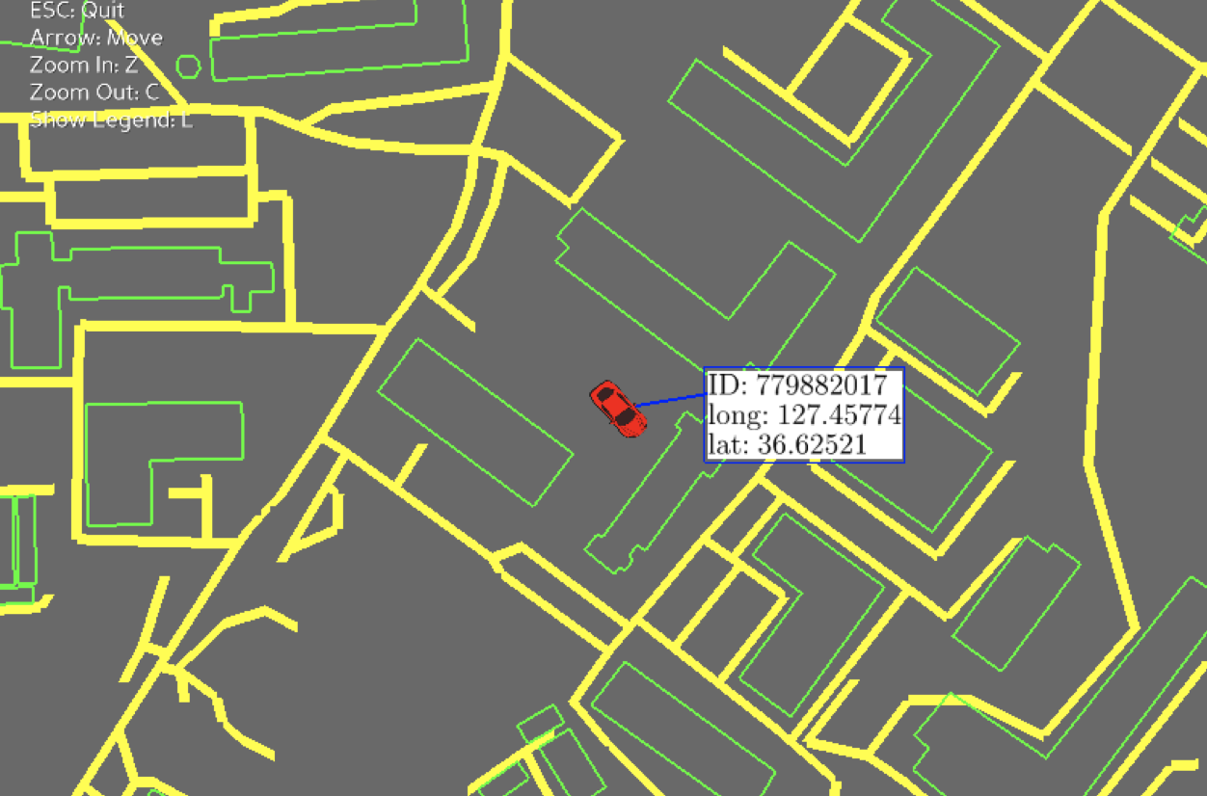
Virtual Drive Test Tool (HIL Simulator)
VSIM: Route creation, Synthesized GPS for multi vehicles
Multi-Vehicle Emulation with Multiple V2X Modules
V2X Protocol & Safety App Running on Each V2x Module
Visualizer Tool shows LDM of each Vehicle (V2X)

